Slide 1

Wireless Communication for IoT 2
ALAA NABIL EL-SHAFAE

Slide 2
Remember?!
ADC
Source Encoding
Channel Encoding
Encryption
Compression
Modulation

Slide 3
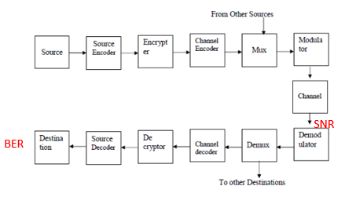

Slide 4
Source Encoding
Using of codes in order to reduce the number of symbols in a message to the minimum necessary to represent the information
it focuses on decreasing the amount of data required to represent the information.
Its aim is to:
Adapt the channel.
Improve efficiency of the system
Minimize bandwidth used
Minimize data size with preserving the Fidelity:
Entropy

Slide 5

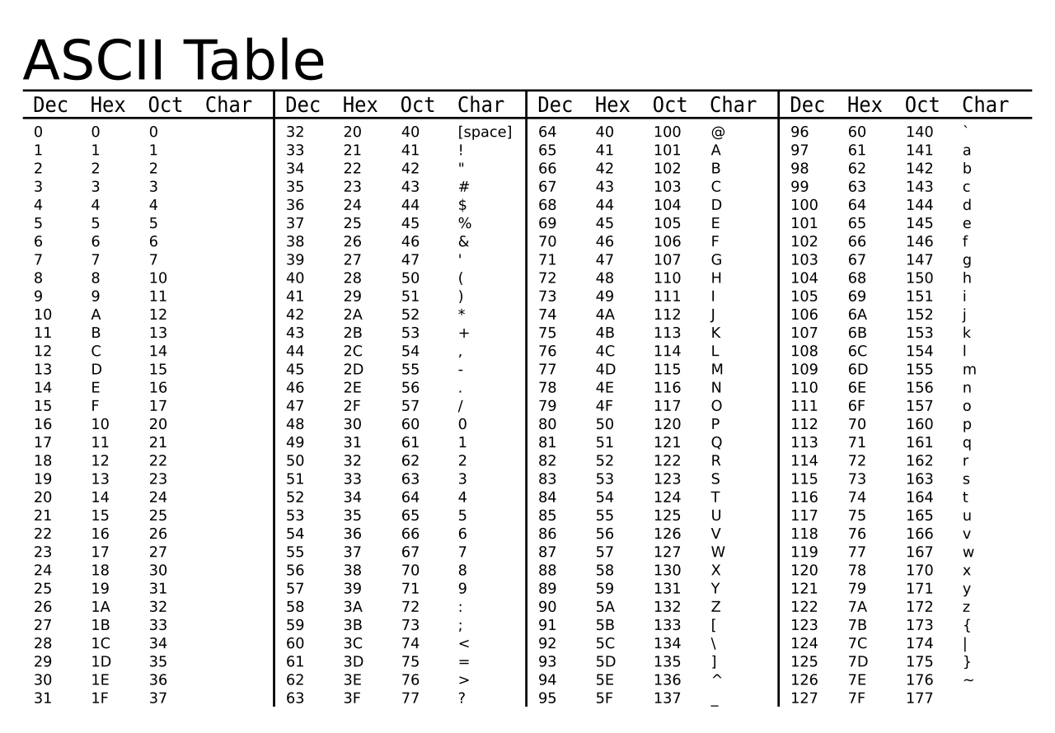

Source codes you already know!!
ASCII Code
JPEG”
MP3

Slide 6
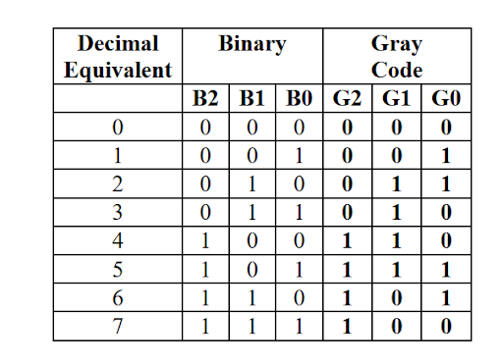
Gray Code
It is a binary numeral system where adjacent values
differ by only one bit. It is designed in a way that
reduces errors caused by changing more than
one bit at a time.

Slide 7
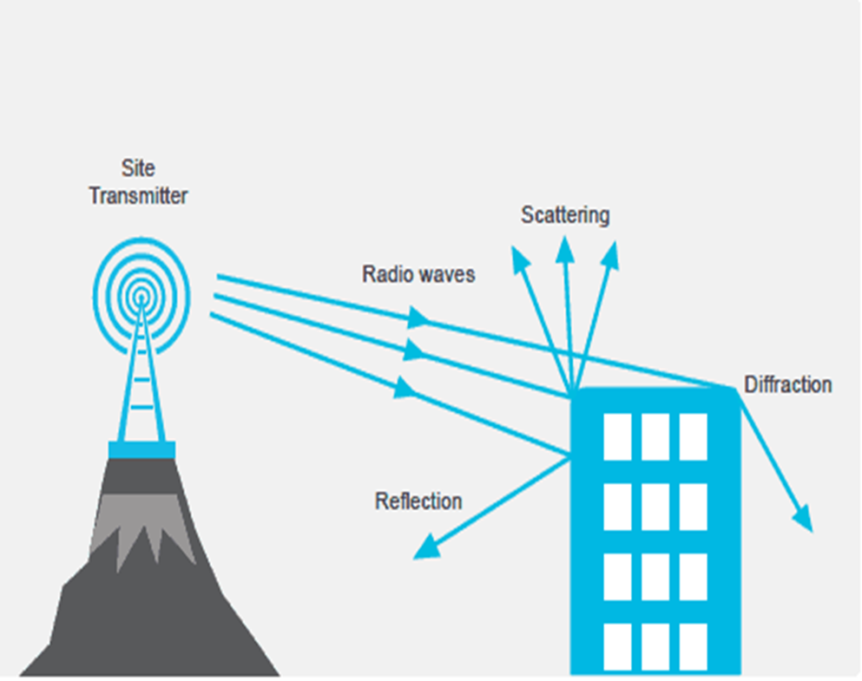
Signal Behavior in Channels
1)Reflection: Bouncing of the signal
2)Scattering: Shattering of signal
3)Diffraction: Deviation of signal
Multi-path propagation
Interference

Slide 8
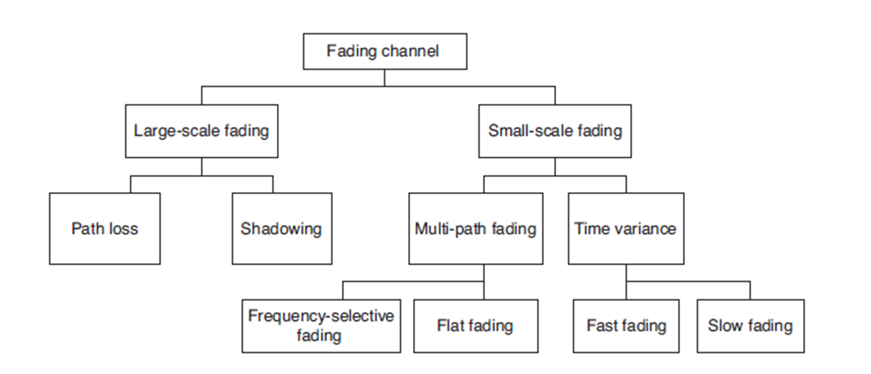
Channel Impairments

Slide 9
Channel Coding/Error Detection and Correction
Block Codes
Convolutional Codes
parity bit
Trellis code
check sum
Turbo codes
CRC
Hamming

Slide 10
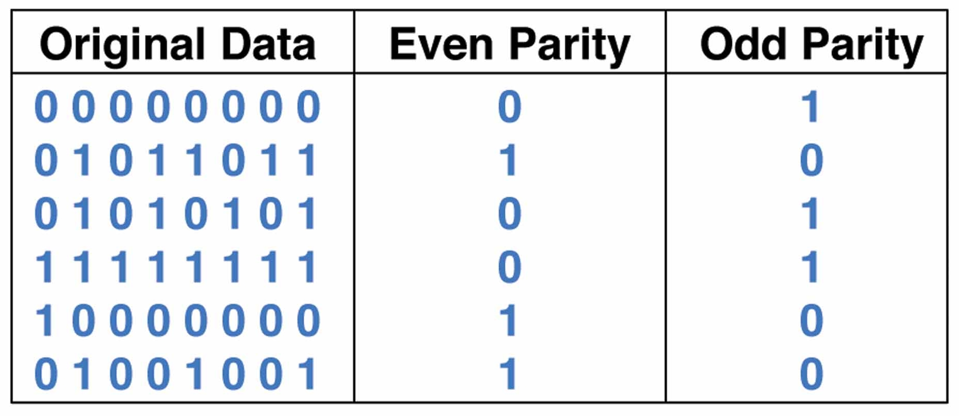
Parity Bits

Slide 11
Hamming Code
Steps:
Determine number of parity bits (2^r >= d+r+1)
Locate parity bits
Each parity bit is responsible for certain data bits
Checking parity bits at receiver
Ex: d= 7, r = 4, total stream =11
Hamming Code in Computer Network - GeeksforGeeks

Slide 12
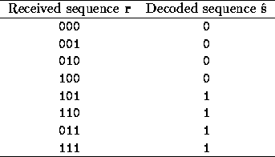
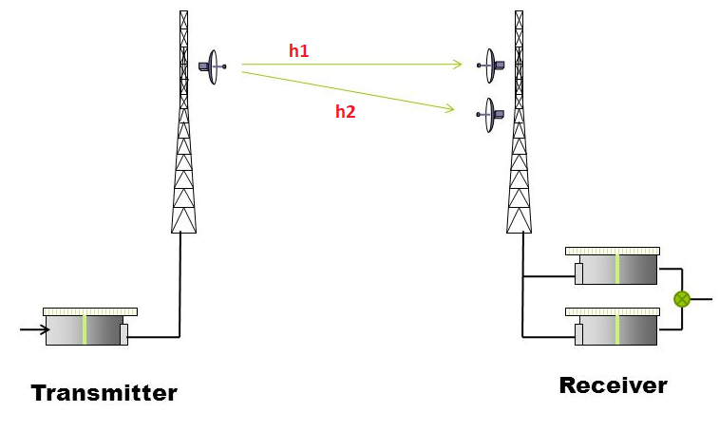
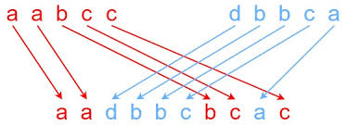
Diversity
Repetition code
Interleaving
Spatial diversity
Frequency Hopping
Notes:
rapidly changing the carrier frequency of the transmitted signal over time according to a predefined pattern or sequence.

Slide 13
Spatial diversity
SISO single input single output
MISO multi in single out
SIMO single in multi out
MIMO multi in muti out

Slide 14
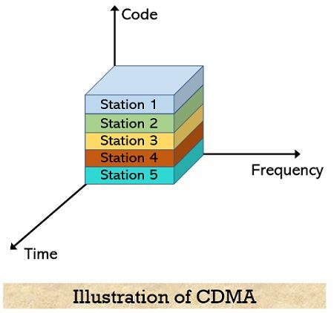
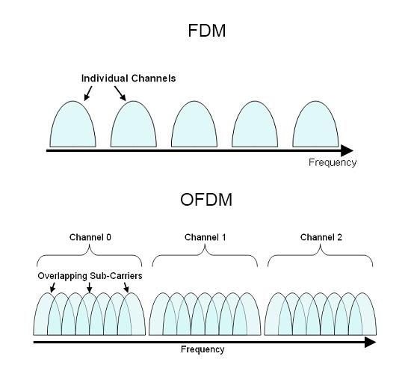
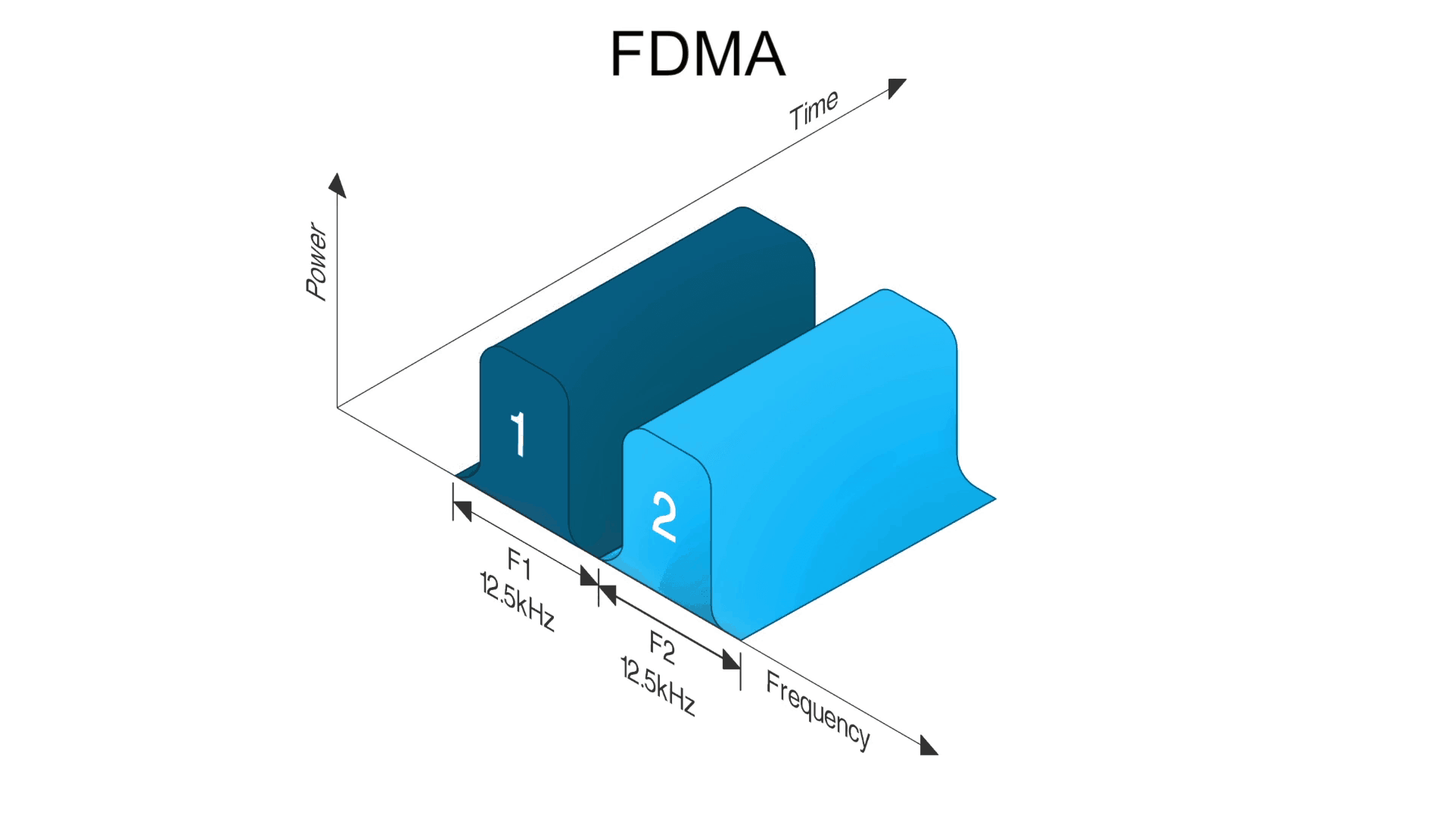
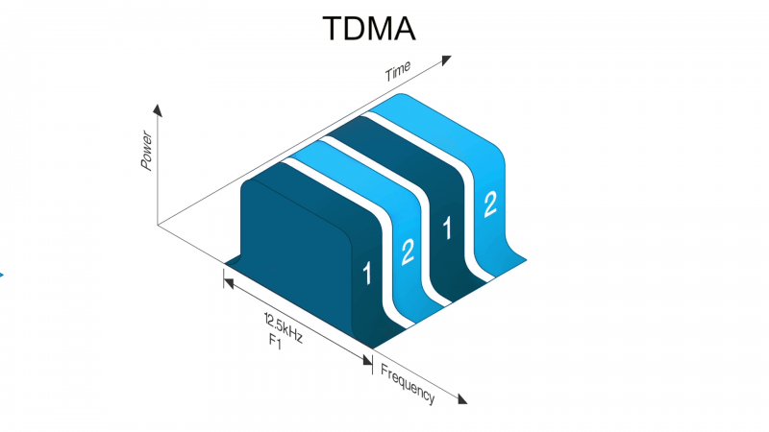
Multiple Access Techniques
TDMA
FDMA
CDMA
OFDMA

Slide 15
AWGN
is the simplest wireless channel model
AWGN is considered additive because it is added to the original signal
white as it affects all the frequency spectrum the same way
Gaussian distribution, also known as the normal distribution

Slide 16
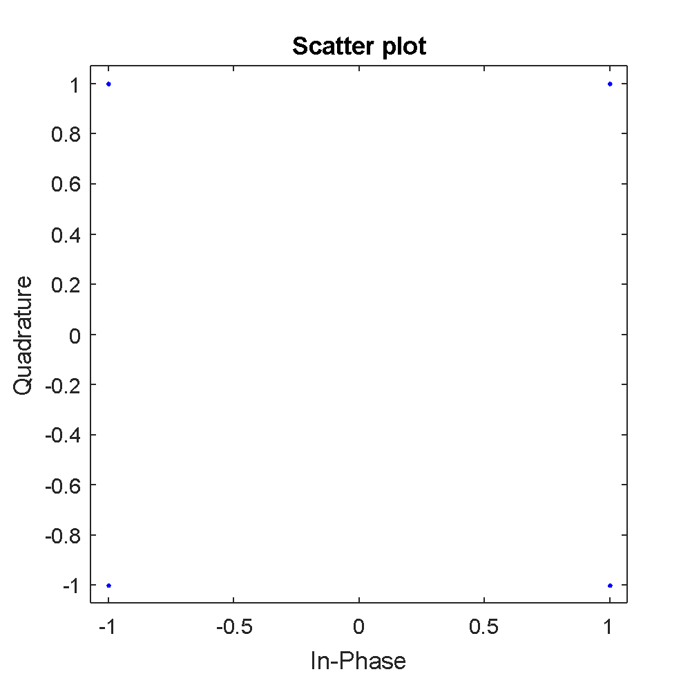
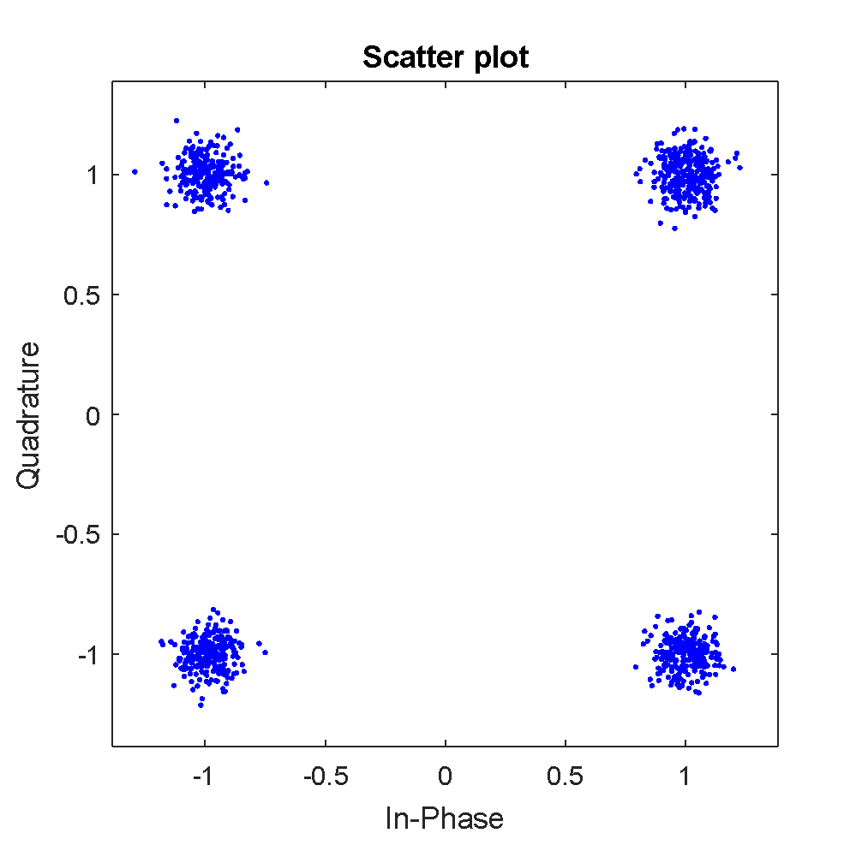
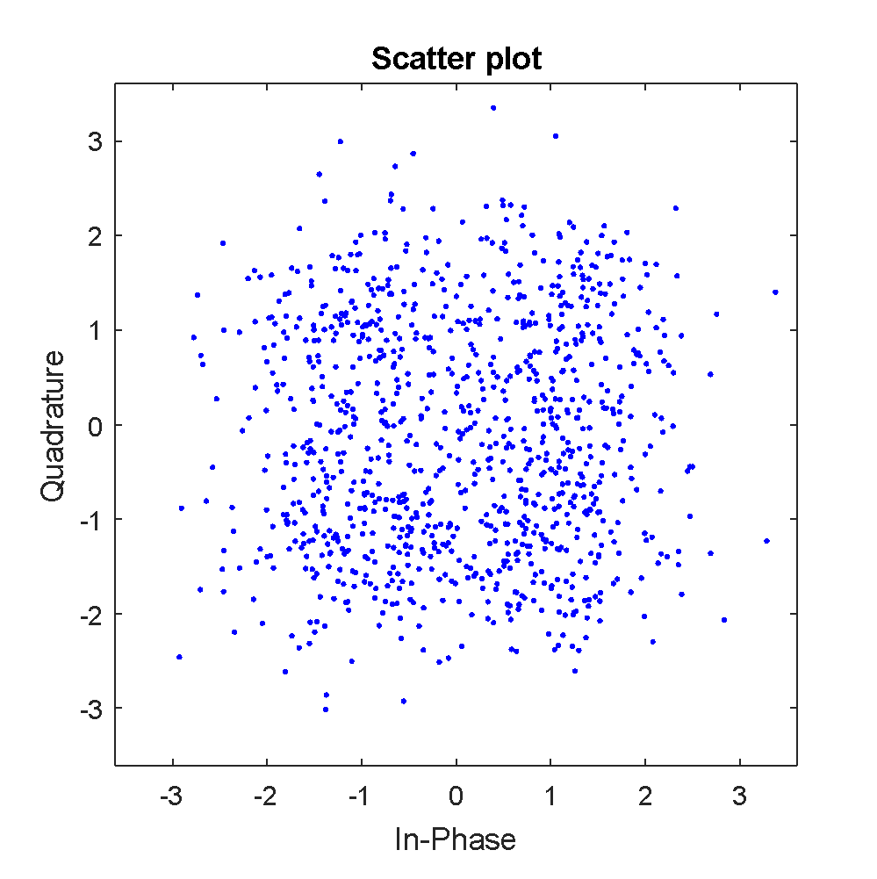
AWGN cont.

Slide 17
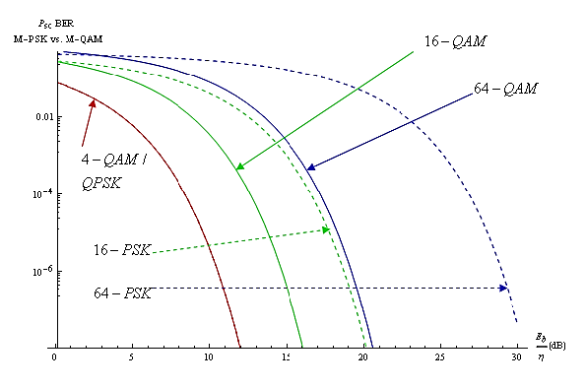
SNR Vs. BER

Slide 18
SNR Vs. BER
The benefits of SNR-BER curve in digital communication are:
It shows you how well the receiver works with changing SNR levels and is arguably one of the best ways to assess overall receiver performance.
It helps you compare the bit error rate (BER) performance of different digital modulation schemes without taking bandwidth into account.
It helps you choose the appropriate forward error correction codes

Slide 19
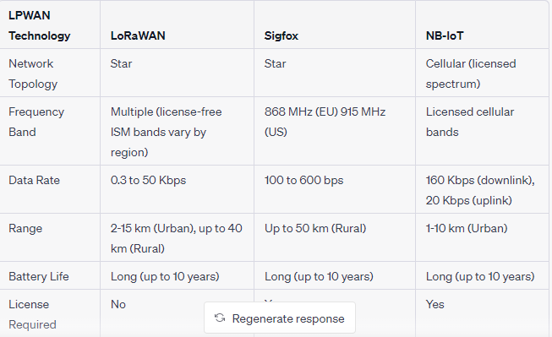
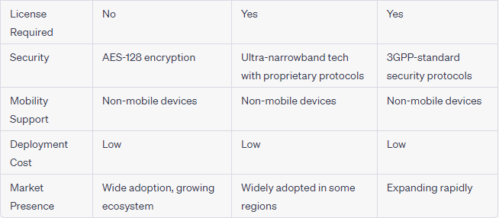
LPWANs Comparison

Slide 20
What We will Learn Today
For:
The basic repetition statement
Non sequential in MATLAB, i.e. Counter doesn’t have to be 1,2,3,4…
NEVER use counter name as i or j
Used for applying the same script over different inputs
Matrices have inner counters for all matrix based operations – no loops needed-
for var = [array] statments end
bertool: [check ber curve for BPSK,QPSK,QAM with different coding and different channels]
What Is Communications Toolbox? - YouTube

Slide 21
What We will Try Today
Write Matlab code to do the following:
Use communication toolbox to draw the BER curve of 4 and 16 QAM over AWGN with SNR 0:20. Hint:- use semilogy

Slide 22
Any Questions

